Slide 1

Predicting factors affecting presence or absence of Heart Disease and determining the gender at risk.
Sai Sravanthi Kilari
Guided by Professor Meeta Pradhan
T.A
Hardik Patel
IUPUI

Slide 2


INTRODUCTION
Cardiovascular diseases are one of the leading cause of death all globally. About one third of death occur due to this diseases worldwide.
Heart diseases refers to any condition that affects structure and function of heart.
In most of heart diseases, a plaque builds inside the arteries thereby narrowing the blood vessel. This leads to blockage of blood flow.
According to WHO, it is estimated that 17.9 million people died because of cardiovascular diseases in 2019, which is 32% of all global deaths.

Slide 3
AIM
AIM 1
The aim of our study is to determine the factors affecting occurrence of heart disease in the Cleveland population.
AIM 2
Which gender is highly affected by heart diseases in the Cleveland population.
OBJECTIVE
The objective of the study is to identify the which factor has maximum influence in the occurrence of heart disease
Which gender is at a higher risk of developing heart disease and by what percentage.

Slide 4
HYPOTHESIS
Null Hypothesis (H0): There is no association between the factors and occurrence of heart disease.
Alternative Hypothesis(H1): There is association between factors and occurrence of heart disease.
DATASET
The dataset we used for our project is Cleveland Heart disease taken from the UCI repository.
Cleveland heart disease data includes 303 individual’s data of age > 29 years.
Data set includes 14 columns age, sex, cp, trestbps, chol, fbs, restecg, thalach, exang, oldpeak, slope, ca, thal, num.
Link:
Index of /ml/machine-learning-databases/heart-disease (uci.edu)

Slide 5
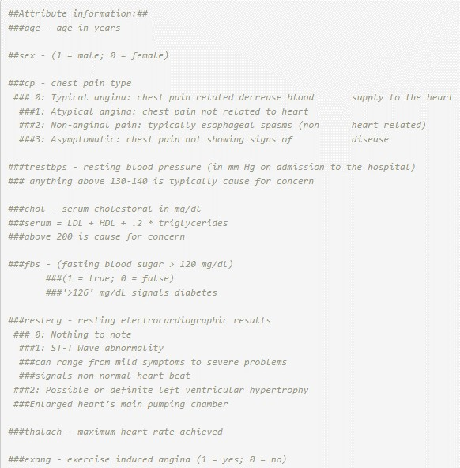
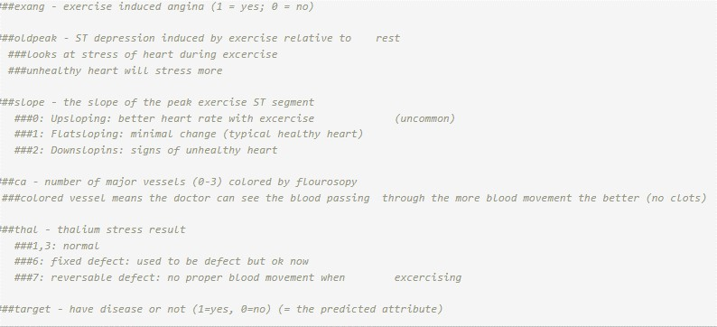

Slide 6












METHODOLOGY
Exploratory Data Analysis
Correlation Analysis
Data Cleaning
Normality Assumptions
Statistical Analysis
Regression Analysis
Predictive Analysis

Slide 7
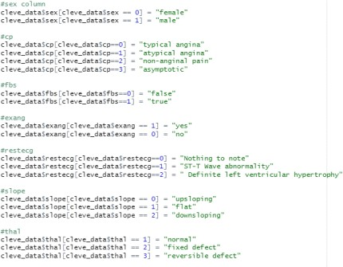
DATA CLEANING
We assigned labels to categorical variables
Removed the outliers

Slide 8


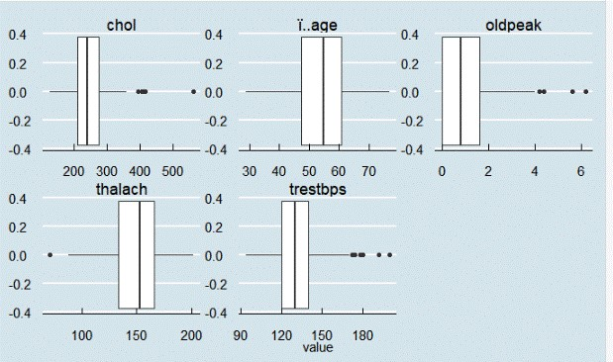
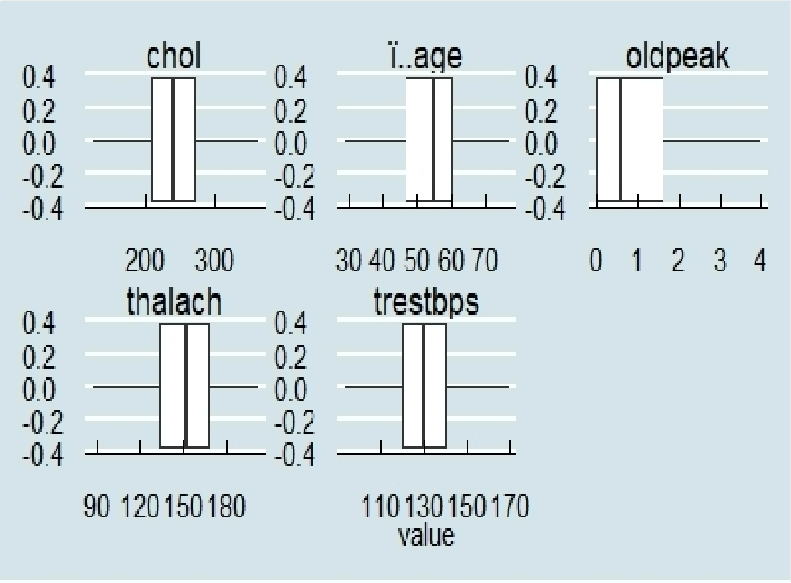
EXPLORATORY DATA ANALYSIS
Box Plots of all variables
B

Slide 9
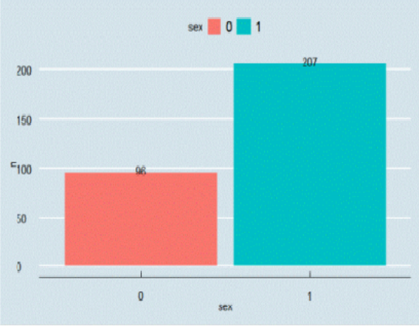
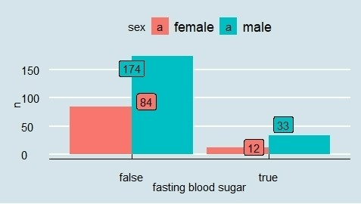
Total males and females
Fbs distribution in males and females
Bar plots of categorical variables

Slide 10
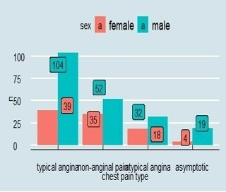
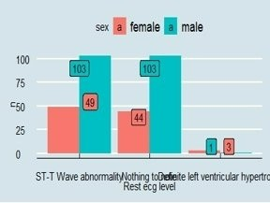
Types of chest pain among males and females
ECG slope among males and females

Slide 11
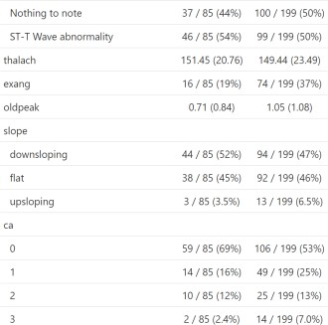
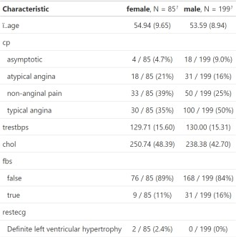
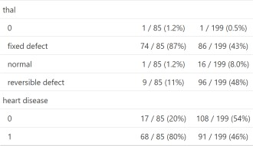
Data distribution
Means of each variable among males and females

Slide 12

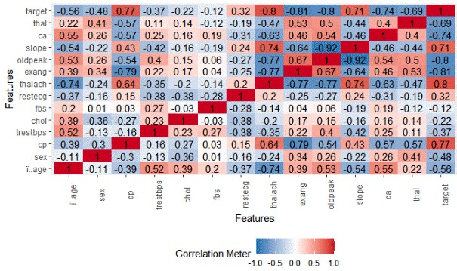
CORRELATION ANALYSIS
Target is our dependent variable.
Highly positive correlated variables are cp (0.77), thalach (0.8), slope (0.71)
Highly negative correlated variables are exang
(-0.81), oldpeak (-0.8), ca (-0.74) and thal (-0.69)

Slide 13
NORMALITY ASSUMPTION
Variables | P values
chol | 5.365 e-19
age | 0.05
ca | < 2.2 e-16
thal | < 2.2 e-16
sex | < 2.2 e-16
cp | < 2.2 e-16
thalach | < 3.76 e-17
oldpeak | <2.2 e-16
Slope | <2.2 e -16
exang | <2.2 e-16
trestbps | < 1.458e -06
restecg | < 2.2e-16
target | <2.2 e-16
Shapiro Wilk Test
All the variable p values are < 0.05 which indicates that the data did not pass the normalcy assumptions.
Based on normality assumptions, we can say that the Shapiro tests are not statistically significant.
Therefore, there is an evidence for rejecting null hypothesis (i.e., data is normally distributed).

Slide 14

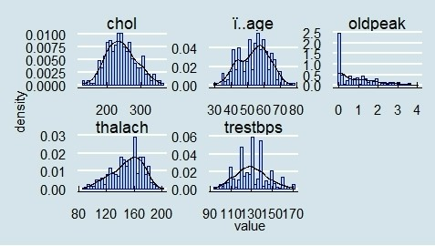
Histograms depicting the data distribution

Slide 15
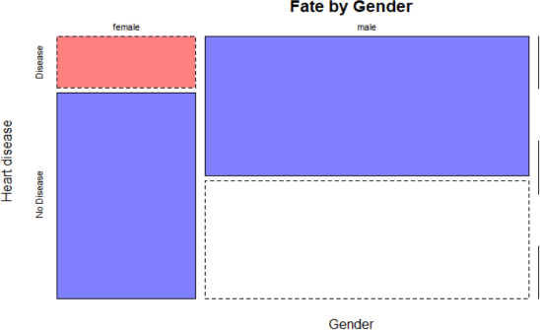
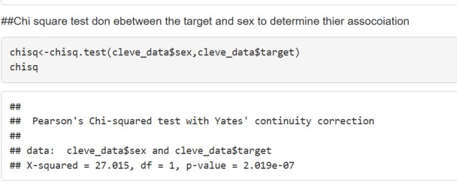
STATISTICAL ANALYSIS
Chi square test
We performed chi square to determine the relationship between the target and sex.
p value is < 0.05 which indicates that there is statistical association between sex and target .
Therefore, we reject the null hypothesis (i.e., there is no association)

Slide 16
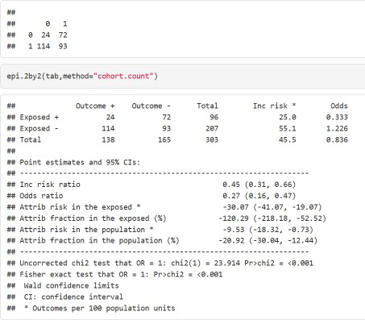
ODDS RATIO AND RISK RATIO
The odds of male having heart disease is 73% more than females
Males are 55% at more risk of developing heart disease

Slide 17
Kruskal Wallis Rank Sum Test
Variables | P values
age | 3.429 e-05
ca | 1.83 e -15
cp | 1.157 e-15
thal | 2.407 e-12
oldpeak | 2.395 e-13
trestbps | 0.0346
chol | 0.03566
sex | 1.049 e-06
restecg | 0.009806
slope | 1.08 e -10
exang | 3.198 e-14
thalach | 9.748 e- 14
All the variables p values are < 0.05 indicating that the not all group medians are equal.
Therefore, there is enough evidence to reject the null hypothesis
Post Hoc Test
We performed Dunn- Kruskal Wallis pair comparison test to determine if there are any differences within the groups and p values adjusted with the Benjamini-Hochberg method for two groups.

Slide 18
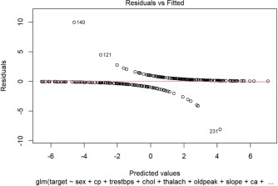
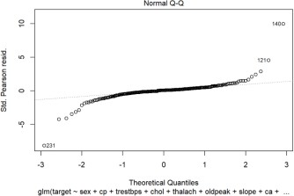
Logistic regression
With step wise AIC backward regression

Slide 19
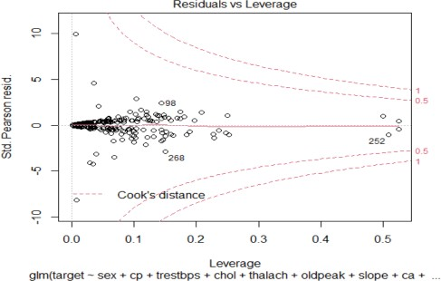
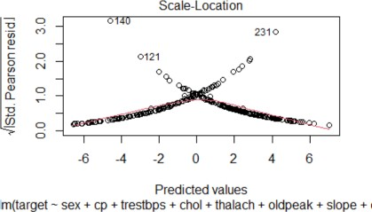

Slide 20
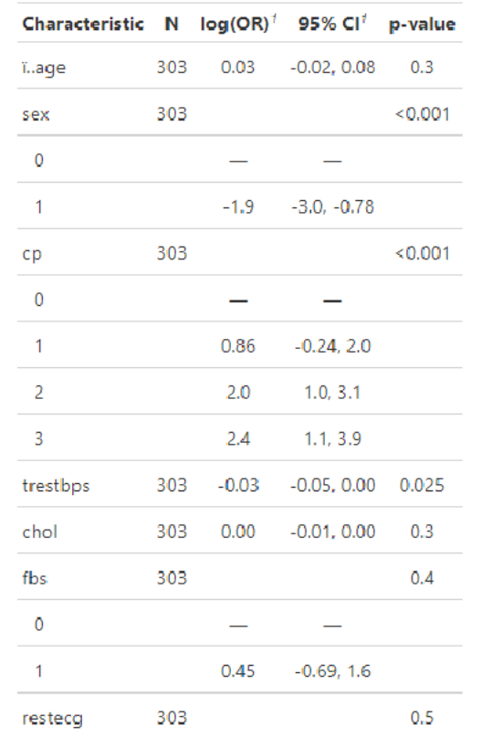
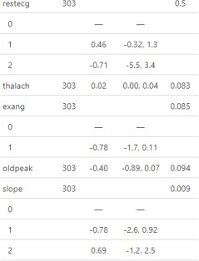
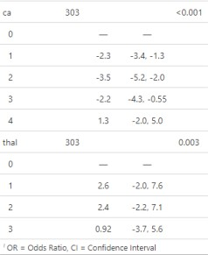
RESULTS
Logistic regression

Slide 21

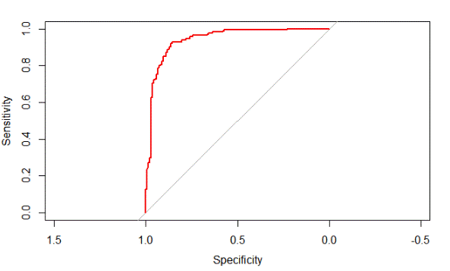

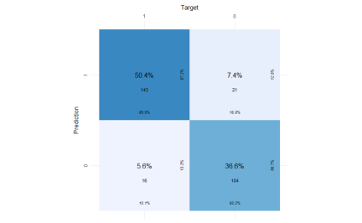
ROC curve
Logistic regression model achieved a very high AUC score of 0.9401.
That means our model was able to correctly predict 0 classes as 0 and 1 classes as 1.
The Higher the AUC, the better the model is at distinguishing between patients with the disease and no disease.

Slide 22

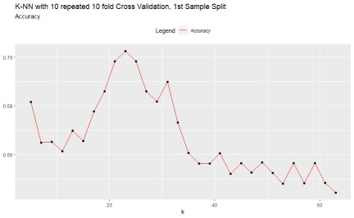
KNN MODEL
k | accuracy | kappa
5 | 0.6743333 | 0.3402848
7 | 0.6743333 | 0.3402099
9 | 0.6618333 | 0.3159125
When K-NN with 10 repeated 10-fold Cross Validation was performed
The accuracy reached to 0.703 at k = 23
Hence, the k=23 is the optimal value of k for the model

Slide 23
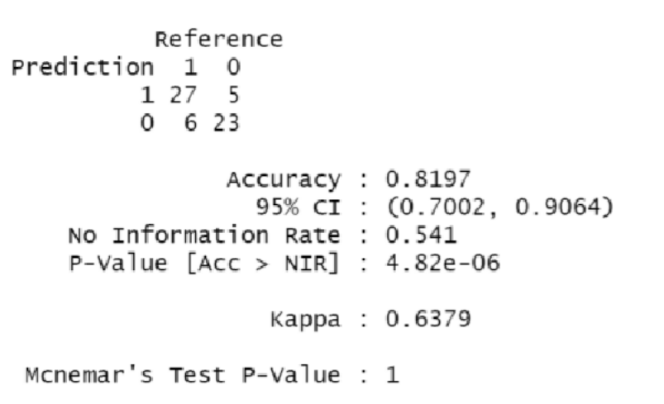
RANDOM FOREST MODEL
The model is 81% Accurate

Slide 24
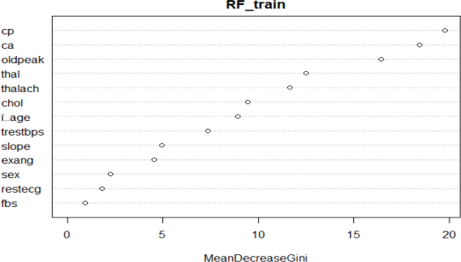
Variable importance from Random Forest

Slide 25
 | Logistic regression | KNN | Random Forest
Accuracy | 0.94 | 0.67(K=5) 0.70(K=23) | 0.803
Kappa | - | 0.33 | 0.6

Slide 26
SUMMARY
 | Shapiro Wilk test | Kruskal Wallis Test | Chi Square | Logistic Regression
Significance value | 0.05 | 0.05 | 0.05 | 0.05
P value | <0.05 for all the variables | <0.05 for all the variables | 2.091e | <0.05

Slide 27
Conclusion
Significant association was found among the variables and the target (which is the presence or absence of heart disease
The variable with highest association is chest pain obtained from random forest
Chi square results indicate that males are at a higher risk than females
Among the machine learning models logistic regression gave the highest accuracy value of
0.94.

Slide 28
Discussion
Most of the variables of the data were categorical in nature.
With correlation analysis, the highest positive correlation was found among thalach but random forest variable importance has shown that chest pain had the highest influence in presence of heart disease.
Among all the machine learning models the logistic regression has the highest accuracy of
0.94 and KNN gave the least (0.67 with K=5)

Slide 29
Critique
The data did not have other important variables that could result in occurrence of heart disease such as BMI underlying comorbid conditions, diet, adverse habits.
We have used only Cleveland data set. However similar data was available for California, Switzerland, South Africa and Hungary.

Slide 30
References
Detrano, R., Yiannikas, J., Salcedo, E., Rincon, G., Go, R., Williams, G., & Leatherman, J. (1984). Bayesian probability analysis: a prospective demonstration of its clinical utility in diagnosing coronary disease. Circulation, 69(3), 541-547. doi: 10.1161/01.cir.69.3.541
Cardiovascular diseases (CVDs). (2021). Retrieved 9 December 2021, from https://www.who.int/news- room/fact-sheets/detail/cardiovascular-diseases-(cvds)
gtsummary: Presentation-Ready Data Summary and Analytic Result Tables (r-project.org)
Heart disease dataset (r-project.org)

Slide 31

Questions?

